Slide 1
IBM Watson OpenScale

Slide 2

I want AI !
Operational
BI and Data Warehousing
Self-Service Analytics
New Business Models
85% view AI as a strategic opportunity
Value
Most
are here
COST REDUCTION
MODERNIZATION
INSIGHT-DRIVEN
TRANSFORMATION
Notes:
As you can see, 85% of enterprises view AI as a strategic opportunity to unlock the business value hidden in their data.​
​
While most organizations are somewhere in the middle, the market is moving to insight-driven self-service analytics and transformational business models.​
​
Where are you on this journey? Once you determine your current state, the next step is to implement a strategy to reach the future state: unlocking the true value of your data. ​
85% believe AI will allow their companies to obtain or sustain a competitive advantage
75% believe AI will enable their companies to move into new business
​
​
​
---------------------------​
Below are some stats and additional information to support the bullet points above. If used, full source accreditation is necessary:​
​
For a typical Fortune 1000 company, just a 10% increase in data accessibility will result in more than $65 million additional net income. (CIO.com –https://www.cio.com/article/3217020/data-management/your-data-accessibility-problem-is-costing-you-65-million.html)​
Average financial impact of poor data on businesses: US $9.7 million per year. (Gartner, as reported in Forbes Corporate Communications, May 2017 - https://www.forbes.com/sites/forbespr/2017/05/31/poor-quality-data-imposes-costs-and-risks-on-businesses-says-new-forbes-insights-report/#41047eb4452b)​
The evolving global regulatory landscape means that all businesses must establish Data Governance as a corporate discipline; this is a requirement that must be taken seriously. (Dataversity.net - http://www.dataversity.net/data-governance-trends-2018/)​
Gartner predicts that by 2019, the analytics output of business users with self-service capabilities will surpass that of professional data scientists. (Gartner - https://www.gartner.com/newsroom/id/3848671)​
40% of companies are struggling to find and retain talent to help them uncover meaningful insights from all the data they own and collect. Applying machine learning everywhere helps businesses automatically and rapidly discover new insights, thereby expanding human capability at scale. (https://www.business.com/articles/big-data-big-problem-coping-with-shortage-of-talent-in-data-analysis/). ​
“In 2021, AI augmentation will generate $2.9 trillion in business value and recover 6.2 billion hours of worker productivity.” (Gartner Predicts 2018 https://www.gartner.com/document/3833572) ​

Slide 3
But ……
In the same MIT & BCG survey of more than 3,000 executives, managers, and analysts across industries…
39%
Of all companies have an AI strategy in place
(50% when only counting companies with at least 100,00 employees)
1/5
Has incorporated AI in some offerings or products
1/20
Has extensively incorporated AI in offerings or process
Notes:
Which means, only 25% (it’s actually less than 25%) have adopted AI

Slide 4
Business stakeholders do not trust AI
60%
Without expensive Data Science resources handholding multiple AI models in a production application:
No way to validate if AI models are compliant with regulations and will achieve expected business outcomes before deploying
Difficult to track and measure indicators of business success in production
Resource intensive and unreliable processes for ongoing business monitoring and compliance
of companies see regulatory constraints as a barrier to implementing AI.
IBM IBV AI 2018
63%
cite availability of technical skills as a challenge to implementation.
- IBM IBV AI 2018

Slide 5


Trusted AI Lifecycle through Open Source Pillars of trust, woven into the lifecycle of an AI application
Did anyone tamper with it?
Is it fair?
Is it easy to understand?
ROBUSTNESS
FAIRNESS
EXPLAINABILITY
Adversarial Robustness 360
↳ (ART)
AI Fairness 360 ↳ (AIF360)
AI Explainability 360 ↳ (AIX360)
github.com/IBM/adversarial-robustness-toolbox
art-demo.mybluemix.net
github.com/IBM/AIF360
aif360.mybluemix.net
github.com/IBM/AIX360 aix360.mybluemix.net
Notes:
ART:
ART is a library dedicated to adversarial machine learning. Its purpose is to allow rapid crafting and analysis of attack, defense and detection methods for machine learning models. Applicable domains include finance, self driving vehicles etc. The Adversarial Robustness Toolbox provides an implementation for many state-of-the-art methods for attacking and defending classifiers
Toolbox: Attacks, defenses, and metrics Evasion attacks Defense methods Detection methods Robustness metric
AIF360:
is an open-source library to help detect and remove bias in machine learning models. AIF360 translates algorithmic research from the lab into practice. Applicable domains include finance, human capital management, healthcare, and education.
The AI Fairness 360 Python package includes a comprehensive set of metrics for datasets and models to test for biases, explanations for these metrics, and algorithms to mitigate bias in datasets and models.
Fairness metrics (70+) Fairness metric explanations Bias mitigation algorithms (10+)
http://aif360.mybluemix.net/
AIX360:
toolkit is an open-source library to help explain AI and machine learning models and their predictions. This includes three classes of algorithms: local post-hoc, global post-hoc, and directly interpretable explainers for models that use image, text, and structured/tabular data.
The AI Explainability360 Python package includes a comprehensive set of explainers, both at global and local level.
Local post-hoc
Global post-hoc
Directly interpretable
http://aix360.mybluemix.net

Slide 6



Watson OpenScale
Validate and monitor AI models, deployed anywhere, to help comply with regulations, address internal safeguards, and mitigate business risk
Monitoring for compliance and safeguards
Mitigate biased model behavior
Explain model decisions
Validate and control risk
Ensure that models are resilient to changing situations
Detect drift during runtime
Generate specific model retraining inputs
Align model performance with business outcomes
Correlate model metrics and business KPIs
Actionable metrics and alerts
Notes:
Align model performance with business outcomes – “if you are thinking about launching an AI model into production, this is a no-brainer”
Ensure that models are resilient to changing situations – “if you are using AI to impact revenue, identify problems with business models or transform operations, you have to track changes in business inputs. Models need to keep up with it much faster than manual review/retrain recommendations”
Prove regulatory compliance and safeguards – “if you are in a regulated industry, there are existing regulations that automated decisions have to meet”; “new controls could get added to GDPR or new regulations being proposed may become a reality in the Digital age”. This will need to be done both during production and before deploying

Slide 7



Bias Mitigation – Guardrails against AI Bias
Watson OpenScale
Online Post Processing
(Intercept & Fix Features)
In-Processing
(Intercept & Fix Algorithm)
Runtime
Pre-Processing
(Intercept & Fix Training Data)
Algorithm Design
Data Selection
Notes:
Each step in this framework works independently of others. However every subsequent step has potential to fix the bias that may leak through previous layers. Thus having the runtime bias correction is one of the most critical step since it provides the outermost guardrail.
AIF360 Also has runtime (post processing) algorithms, but those algorithms simply flip the output of the model based on heuristics to fix the group fairness. In essence there is a potential of fixing the fairness statistics at the cost of some arbitrary and costly changes to individual transaction. We recommend Watson OpenScale approach to flip the input feature vector instead and let the original model decide whether it wants to continue to keep the output the same or change it.

Slide 8




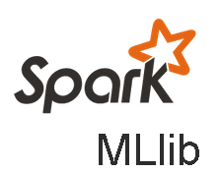

Open: Monitor and optimize models deployed on any model serve engine, beyond WML
Description:
Use Watson OpenScale to monitor models developed in a 3rd party IDE, open source framework and hosted in a 3rd party or private model serve engine
Model build/train frameworks
Value:
Automate and Operationalize AI wherever your AI and applications reside
Leverage flexibility and innovation of open source model building and training frameworks
Retain existing data and model pipelines deployed to support applications in production
Extend investments in skills and tools deployed as part of current data science and AI stacks
Model serving environments

Slide 9
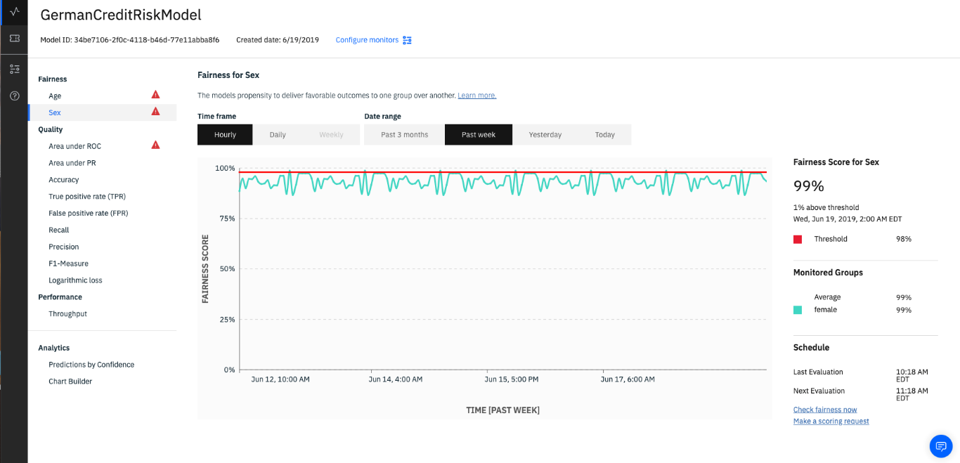
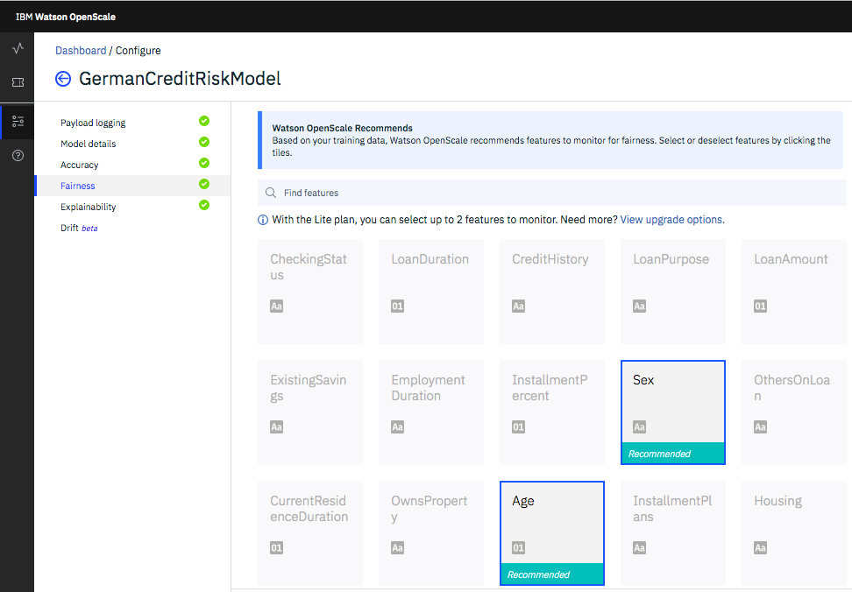
Bias Detection
OpenScale enables enterprises to enforce fairness in their model’s outcome by analyzing transactions in production and finding biased behavior by the model
It pinpoints the source of bias and actively mitigates the biases found in production environment
Value:
Automatically recommend common protected attributes to monitor during production
Detect biases in pre-production and in runtime in order to catch impacts on business applications and compliance requirements without time consuming, manual data analysis
Metrics and data to help data scientists further troubleshoot issues in data sets or models
Mitigate biases in runtime in order to enforce regulatory or enterprise fairness guardrails in real time

Slide 10
How does Watson OpenScale mitigate fairness issues?
Calculated hourly over a sliding window
variants over subset of data
applicant credit histories
risk model
internal bias detection model
perturbation
analysis
FAIR
UNFAIR
Notes:
Key takeaways
Calculated on an hourly basis (over a sliding window defined by the user)
Optimizations identify the right subset of data to perturb rather than perturbing all the data
Perturbed data is sent to the deployed model to determine effect of perturbations.
An internal bias detection model (logistic regression) is built using perturbed data that classifies whether new prediction will be biased or not.
Users receive both the original prediction plus the internal model’s classification of whether the monitored model’s prediction is biased or not. Passive and Active debiasing

Slide 11
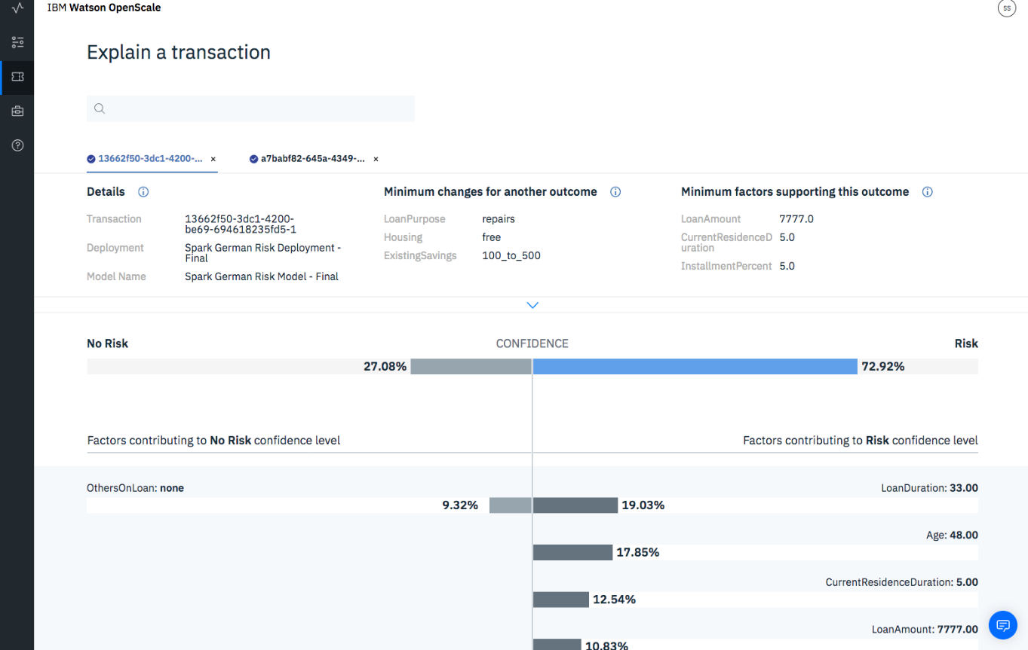
Explainability
OpenScale records every individual transaction and drills down into its working to explain how the model makes decisions
It provides a simple explanation that is user friendly and interactive
Value:
Explain individual transaction level decisions made by the model in run time, including details about most important attributes and their values in order to assist in compliance and customer care situations
Analyze individual transactions in a what-if manner in order to understand how model behavior will change in different business situations

Slide 12
How does Watson OpenScale explain a prediction?
Calculated upon request
1000’s of variations
applicant credit history
risk model
internal explanation models
perturbation
analysis
LOCAL EXPLANATION
(LIME)
CONTRASTIVE EXPLANATION
Notes:
Key takeaways
Calculated on an hourly basis (over a sliding window defined by the user)
Optimizations identify the right subset of data to perturb rather than perturbing all the data
Perturbed data is sent to the deployed model to determine effect of perturbations.
An internal bias detection model (logistic regression) is built using perturbed data that classifies whether new prediction will be biased or not.
Users receive both the original prediction plus the internal model’s classification of whether the monitored model’s prediction is biased or not. Passive and Active debiasing

Slide 13
LIME and Contrastive Explanations
Lime Output:
Set of features which played a positive role or negative role in the prediction.
Also identifies the feature weights which helps to identify the most important or least important features
Contrastive Explanation:
Explains the behavior of the model in the vicinity of the data point whose explanation is being generated.
Assumption:
The most common value is the least interesting from an explanation point of view
E.g., If median salary is between $70-90K, then someone who has a salary of $80K it is not very “interesting” or to say it differently it is “normal”.
However, if someone has salary of $200K, it is very “interesting”

Slide 14
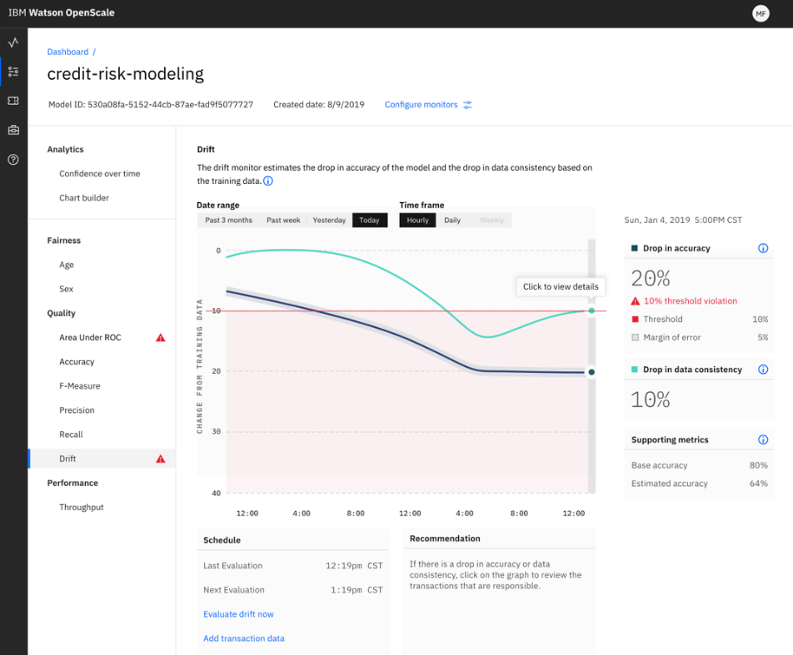

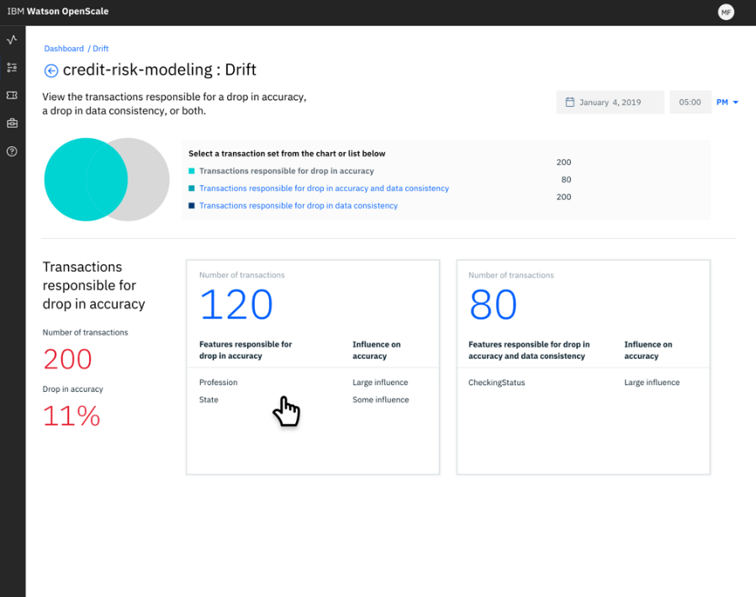
Watson OpenScale will automatically detect drifted transactions and pinpoint datapoints that contribute to drift
Business environments are dynamic leading to “drift” in data and cause inaccuracies in model prediction
Weather data changes in short term can affect long term climate models
Online shopping behavior
Rise in income levels in specific geos can throw off global models
Notes:
Align model performance with business outcomes – “if you are thinking about launching an AI model into production, this is a no-brainer”
Ensure that models are resilient to changing situations – “if you are using AI to impact revenue, identify problems with business models or transform operations, you have to track changes in business inputs. Models need to keep up with it much faster than manual review/retrain recommendations”
Prove regulatory compliance and safeguards – “if you are in a regulated industry, there are existing regulations that automated decisions have to meet”; “new controls could get added to GDPR or new regulations being proposed may become a reality in the Digital age”. This will need to be done both during production and before deploying

Slide 15
Drift Detection in OpenScale
Drift Monitor in OpenScale measures two types of drifts:
Drop in accuracy: It estimates the drop in accuracy of the model at runtime. The model accuracy could drop if there is an increase in transactions similar to those which the model was unable to evaluate correctly in the training data.
Drop in data consistency: It estimates the drop in consistency of the data at runtime as compared to the characteristics of the data at training time.
A drop in model accuracy and data consistency may lead to a negative impact on the business outcomes associated with the model.
OpenScale measures the drift without requiring labelled data. Accuracy computation using labelled data can be expensive and might not be comprehensive
OpenScale does Drift detection on the entire payload data
IBM Cloud / Watson and Cloud Platform / © 2018 IBM Corporation

Slide 16



IBM also has a long history in the open source ecosystem. We are leveraging this to bring tools that help to deploy and operate trusted AI though Open Source..
Notes:
Open source, open governance, and open communities are clearly empowering developers, regardless of their technology area, to contribute their skills and expertise for the greater good. Developers can and do make a significant difference through open source. From the start of open source, IBM has seen the areas of open collaboration on technologies, governance, and community to be critical to moving technology forward and actively promote, contribute to, and leverage open source.
From our work with Apache, Linux, and Eclipse to our current work across all layers of the cloud stack, application development, blockchain, artificial intelligence, quantum computing, and machine learning, IBM has demonstrated a sustained commitment to driving innovation in open source, delivering a broad portfolio of offerings based on open source, and helping to build sustainable, thriving communities and ecosystems around those open source projects about which we care the most.
In fact, IBM is one of the most prolific companies making contributions of open source code to GitHub organizations and repositories.
At IBM, we believe that our leadership in open source is a differentiating value for our clients
https://www.apache.org/foundation/press/pr_1999_06_30.html
1999, IBM instrumental in the creation of the Apache Software Foundation (ASF),
IBM will also be providing code and a dedicated team of programmers to the Apache Software Foundation, including the Jakarta Project and will use the resulting code in its commercial products, similar to its use of the Apache Web Server today.
https://www-03.ibm.com/press/us/en/pressrelease/1025.wss
2001, IBM today announced it is donating $40 million of software to a new independent open-source community. The Java-based open source software, code-named Eclipse, will enable developers to use software tools from multiple suppliers together, allowing developers to integrate business processes used to create e-business applications, such as those for Web services.
(Eclipse was an integrated development environment that helped developers to create applications)
https://www-03.ibm.com/press/us/en/pressrelease/2088.wss
IBM pushes Linux into the mainstream business market
https://en.wikipedia.org/wiki/Linux_Technology_Center
1999, IBM creates the Linux Technology Center as a focal point for its technical contributions to Linux. The center, which has a dedicated staff of engineers, manages the transfer of IBM technology to the open source community.

Slide 17

20

